Slide 1

PRESENTATION ON
Amazon Lipstick Sales Analysis
Presented by:
Mamidi Hema Goud
Batch no: 456
Branch : Dilsukhnagar

Slide 2
Agenda
Introduction
Business Problem
Objective of Project
Web Scraping – Details
Tools and Technologies used
Data Description
Exploratory Data Analysis (EDA):
Data cleaning & manipulation
Univariate analysis
Bivariate analysis
Multivariate analysis
Hypothesis
Challenges & Key Recommendations
Conclusion

Slide 3
Introduction
Online shopping is widely used, and Amazon is one of the platform for buying lipsticks.
Lipstick product data was collected from Amazon through web scraping.
The dataset contains details such as brand name, price, and customer ratings.
Exploratory Data Analysis (EDA) was used to understand the data clearly.
The analysis helps identify popular lipstick brands and common price ranges.
These insights can help companies improve product planning and marketing strategies.

Slide 4
Business Problem
Naina lilhare is a working professional searching for a lipstick for regular use on Amazon.
She notices that many lipsticks look similar in quality and features, yet their prices vary widely.
This makes it difficult to understand what factors actually justify higher prices.
Such unclear pricing creates confusion for customers and affects purchase decisions.
The business problem is to identify the key factors influencing lipstick prices.
This project uses Exploratory Data Analysis (EDA) to bring clarity to pricing and value.

Slide 5
Objective of Project
To analyze lipstick product data to understand pricing, ratings, and customer preferences.
To compare budget, mid-range, and premium lipsticks across different brands.
To study the relationship between price, discounts, and customer ratings.
To identify value-for-money lipsticks that help customers make better purchase decisions.

Slide 6
Web Scraping – Details
Data collected from Amazon India using web scraping.
Focused on the Lipsticks product category.
Extracted structured data from multiple product pages.
Key fields included:
  Brand Name, Price, Rating, Shade_Names
  Other Attributes (availability, discount, category, etc.)
Provides real-time market information.
Data cleaned and organized into a tabular format for analysis.

Slide 7
Tools and Technologies used
Python - core programming language
Selenium - for browser automation and scraping dynamic content
Requests - for sending HTTP requests to Amazon pages
Pandas – For storing and cleaning Data
Matplotlib & Seaborn – For Visualization

Slide 8
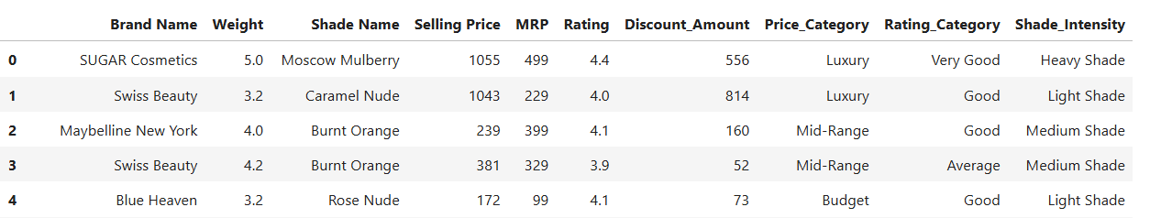
Data Description
The dataset contains 420 lipstick products.
It includes Brand_name, weight ,shade_name, and shade_intensity details.
Pricing information covers MRP, selling price, and discount amount.
Customer ratings are recorded on a 5-point scale.
Products are grouped into price and rating categories.
Shade intensity indicates light, medium, or heavy shades.

Slide 9
Data Cleaning & Manipulation
1. Handling Data Types
Converted MRP and Selling Price columns to integer format.
Converted Rating column to numeric (float) for accurate analysis.
Converted categorical columns such as Price Category, Rating Category, and Shade Intensity to category data type.
2. Feature Engineering
Created Discount Amount by calculating the difference between MRP and Selling Price.
Generated Price Category to group lipsticks into Budget, Low-Mid, Mid, Upper-Mid, and Premium.
Created Rating Category to classify customer ratings into Poor, Average, Good, and Excellent.
3. Handling Missing Values
Filled missing values in Rating and Rating Category using the mode technique.
4. Outlier & Data Consistency Check
Used boxplots to detect outliers in numerical variables.
Identified negative values in Discount Amount.
Converted negative discount values to positive using the absolute value method to ensure data consistency.

Slide 10
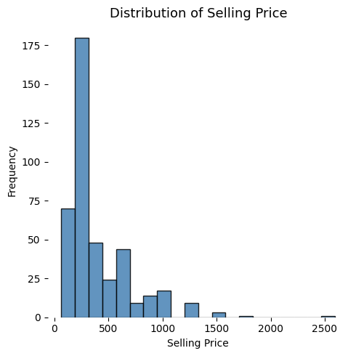
UNIVARIATE ANALYSIS
Plot Type: Histogram
Insights:
Most lipsticks are low-priced, showing people prefer affordable options.
Expensive lipsticks are few, and only a small number fall in the premium range.

Slide 11
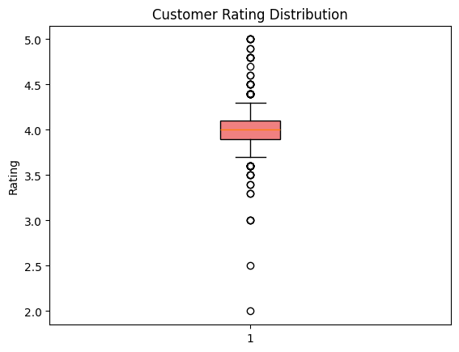
Customer Rating Distribution
Plot Type: Box Plot
Insights:
Most lipsticks have ratings around 4, showing good customer satisfaction.
Very few products have very low or very high ratings.

Slide 12
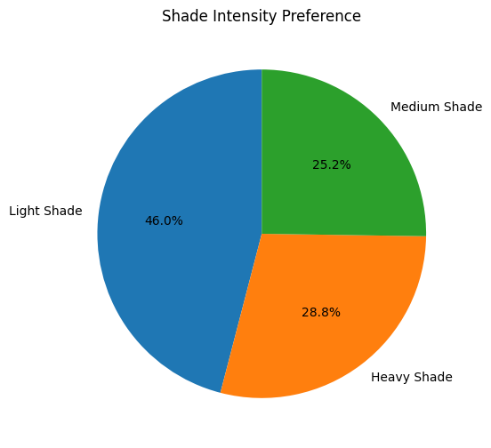
Shade Intensity Preference
Plot Type: Pie Chart
Insights:
Light shades are the most preferred by customers.
Medium and heavy shades have lower but notable demand.

Slide 13
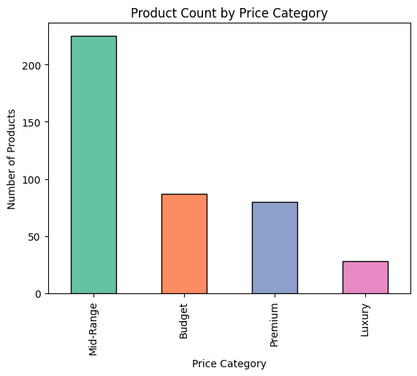
Product Count by Price Category
Plot Type: Bar Chart
Insights:
Most products belong to the mid-range price category.
Luxury products are very few compared to other categories.

Slide 14
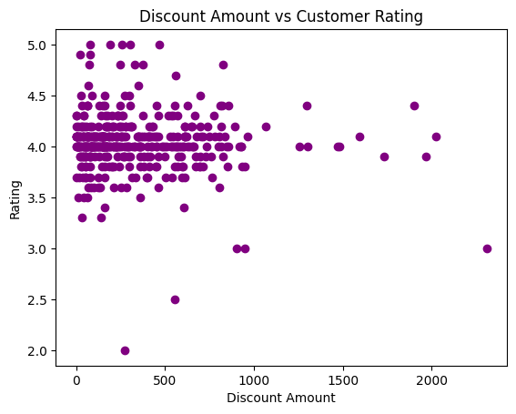
BIVARIATE ANALYSIS¶
Plot Type: Scatter Plot
Insights:
Most products get good ratings, even with small discounts.
Bigger discounts do not always mean better ratings.

Slide 15
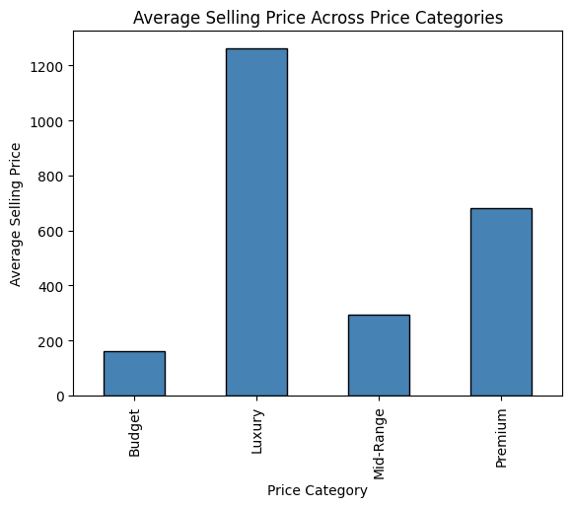
Average Selling Price Across Price Categories
Plot Type: Bar Chart
Insights:
Luxury products have the highest average selling price.
Budget products have the lowest average selling price.

Slide 16
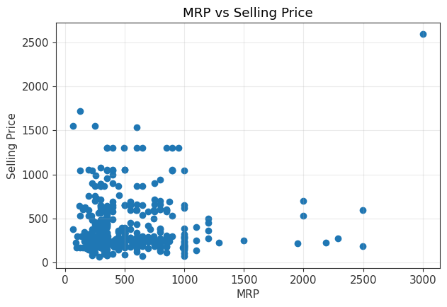
MRP vs Selling price
Plot Type: Scatter Plot
Insights:
Most products have selling prices much lower than their MRP, showing heavy discounts.
A few high-MRP products exist, but they are sold in very low numbers.

Slide 17
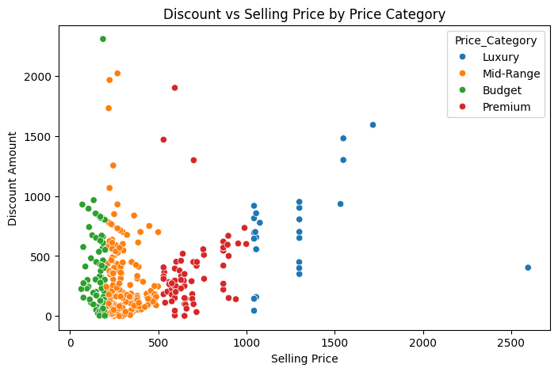
Multivariate Analysis
Plot Type: Scatter Plot
Insights:
Higher-priced lipsticks generally have higher discounts.
Budget and mid-range products are clustered at lower prices with smaller discounts.

Slide 18
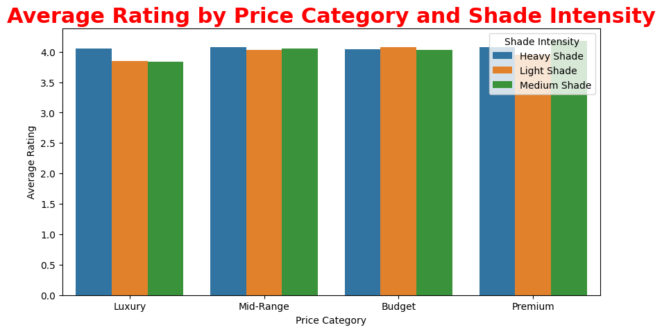

Plot Type: Bar Plot
Insights:
Most lipsticks have good ratings for all types of shades.
Customers care more about product quality than shade or price.

Slide 19
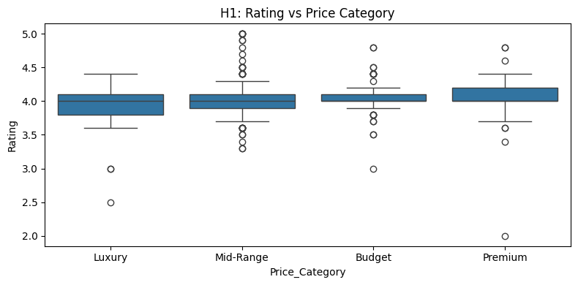
Hypothesis 1
Plot Type: Box Plot
Do customer ratings differ across price categories?
Conclusion:
Fail to reject the Null Hypothesis.
Customer ratings are almost the same for budget, mid-range, luxury, and premium products, so paying more does not always mean better ratings.

Slide 20
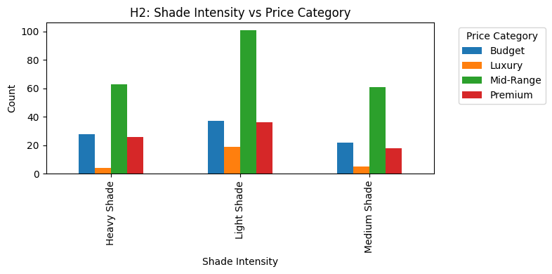
Hypothesis 2
Plot Type: Bar Chart
Is shade intensity dependent on price category?
Conclusion:
Reject the Null Hypothesis.
Light shades are more popular across all price categories, especially in mid-range products, indicating that price category influences shade intensity preference.

Slide 21
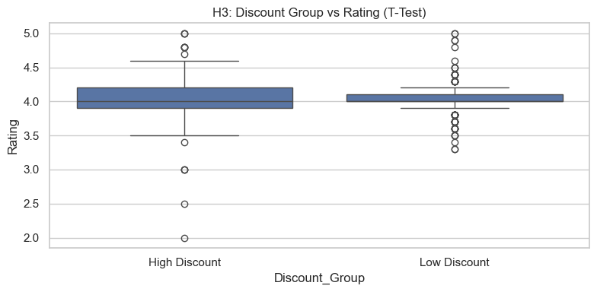
Hypothesis 3
Plot Type: Box Plot
Does discount level influence product rating?
Conclusion:
Fail to reject the Null Hypothesis.
Customer ratings are similar for both high-discount and low-discount products, indicating that higher discounts do not significantly impact customer ratings.

Slide 22
Challenges Faced
Amazon has strict scraping restrictions, making data collection difficult.
Prices and discounts change frequently, so data may vary over time.
The same lipstick is sold by multiple sellers, causing price and rating differences.
Some products have limited or biased reviews, affecting analysis accuracy.

Slide 23
Key Recommendations
Focus more on product quality rather than offering very high discounts.
Maintain a strong range of affordable and mid-range lipsticks, as these are most preferred by customers.
Use moderate discounts instead of heavy discounts to protect brand value.
Improve shade and finish descriptions for better customer understanding.

Slide 24
Conclusion
Lipsticks are the most commonly purchased in cosmetic products.
Most lipsticks fall in the Budget and Low-Mid price range.
Ratings are generally good (around 3.5 to 4.5).
Matte and regular-use lipsticks are used the most.
Prices and ratings vary by brand and lipstick type.
Discounts are mostly similar across lipstick categories.
Overall: Affordable, well-rated lipsticks are the most popular, and targeted marketing can improve sales.

Slide 25

THANK YOU

